Slide 1
Creating an API from Scratch
CIS 4250 Professor Ivan Panteleon
By
Adrian, Ali, Beth, Nazmul, Will

Slide 2
Agenda
What is an API
What applications did we need for this project in AWS
Cloud9, API Gateway
IAM, CloudWatch, Cognito
Creating the API
Testing the API
Business Case
Project Roadblocks
What we Learned
Project Summary

Slide 3
What is an API?
An API, or Application Programming Interface is a way for two more computer programs or components to communicate with each other
We see API integrations everywhere in our daily lives
TikTok – where we can post videos from this social media platform to another like Instagram or X
Other uses:
Apple Pay for online purchases
Microsoft Teams opening MS Word, Excel, or Power Point in its interface
Canvas being able to upload documents from cloud repositories like Google Drive

Slide 4
Our Project
Amazon Web Services Project
Creating an API from scratch with OpenAPI and AWS SAM
Open API
Is a specification language that defines structure and syntax in a way that is not wedded in the programming language the API is created in
AWS SAM
Is an open-source framework that creates serverless application models
Uses templates to define infrastructure code

Slide 5

Before We Get Started
Create an AWS account for free
Amazon Web Services applications we used
Cloud9, API Gateway
Cognito, CloudWatch, IAM
Cloud9 and API Gateway are two services we will use to create and test the API
Cognito, CloudWatch, and IAM are all auxiliary services we used to create additional functionality within the API

Slide 6
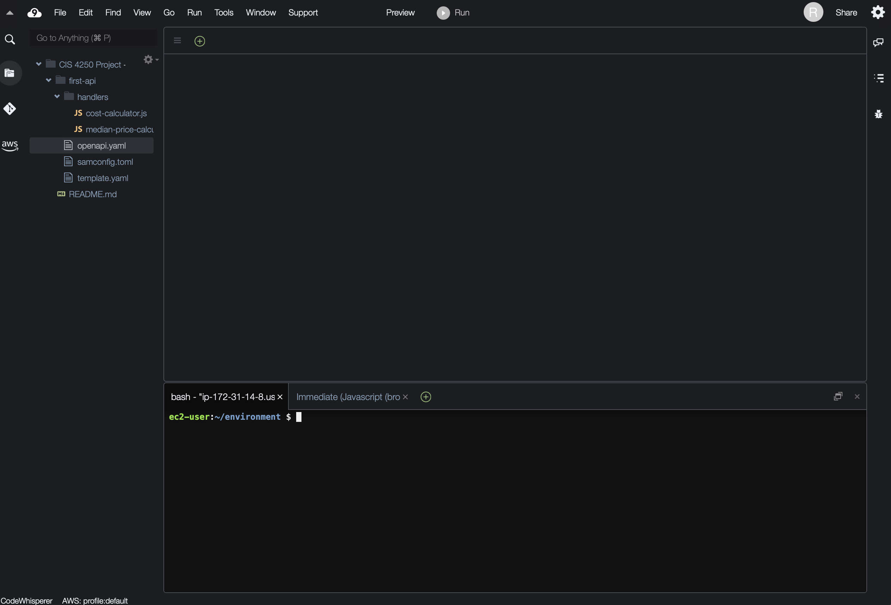
Starting the Project
First step is to open Cloud9 and create the following Directories and files
Directories
First Api
Handlers
Files
First API > openapi.yaml, template.yaml
Handlers > cost-calculator.js, median-price-calculator.js
.YAML files will create and deploy the API
.JS files will be the API code itself

Slide 7
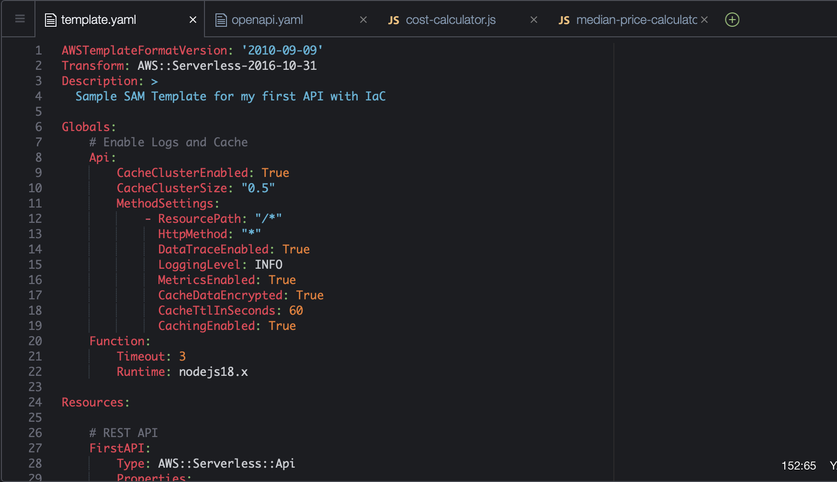
.YAML File Content
The first file : template.yaml
Lines 1-4 : CloudFormation template
Lines 6-17 : declare common configurations, enables logs, traces resources & methods of first API
Lines 19-63: defining - First API, Cost calculator, and Lambda Execution Rule.
Lines 64-67 : Outputs for the stacks
The second file : openapi.yaml
Lines 1-5 : defining the Open API & other info of the First API
Lines 7-28 : paths sections (individual endpoints, HTTP, and POST )
Lines 18-28 : IAM role & setting the uri to merge costcalultor.

Slide 8
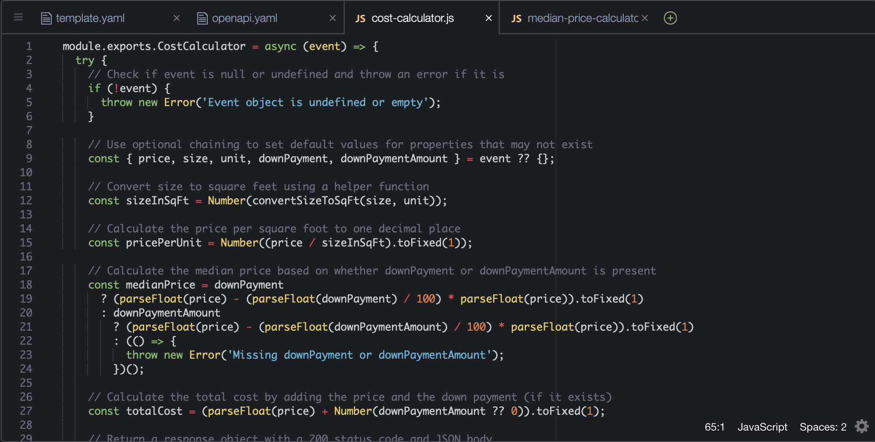
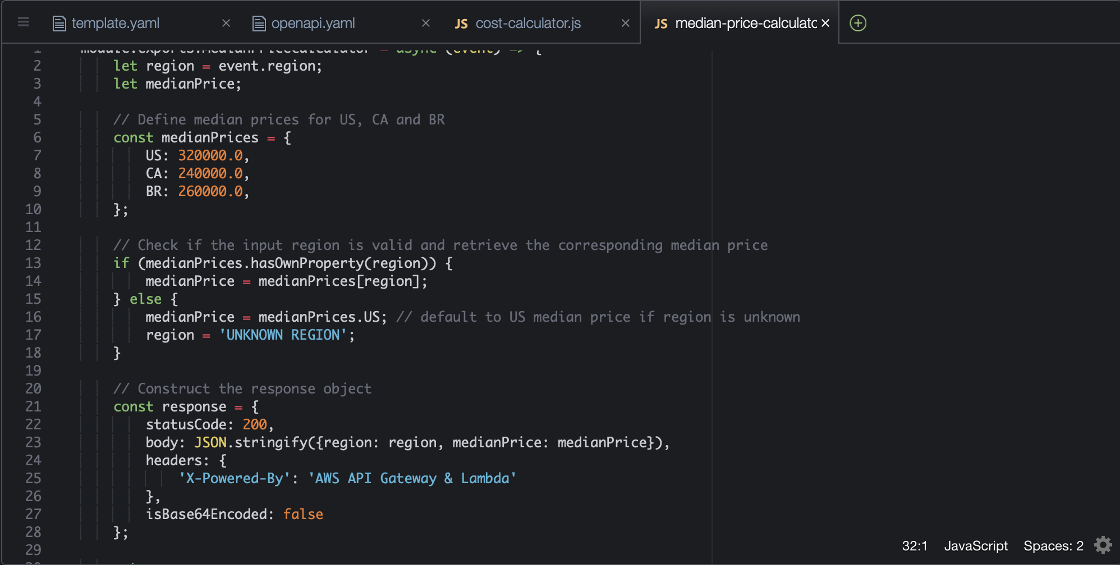
.JS File Content
First file : cost-calculator.js
The function receives the event parameter (JSON→Lambda function) back to the calculated cost.
Second file : median-price-calculator.
The function receives the event parameter (JSON→Lambda function) back to the median price based on the region.

Slide 9

Project Code and Steps
The code found in each file is provided by the AWS Project outline and is updated step by step as we followed the AWS Project
You are seeing the final code used for our finished project
After initially uploading code for the .JS files, we would only update the openapi.yaml and template.yaml files
At each new step where we updated or added code, we would need to rebuild and redeploy the API

Slide 10
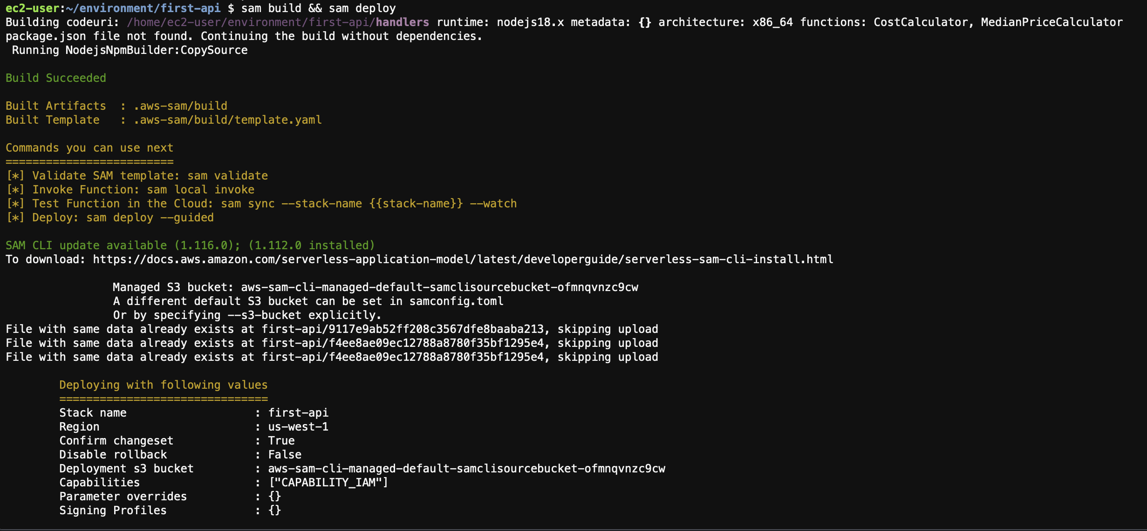
Create the API
Once the files have the code we will use the following code
SAM BUILD && SAM DEPLOY --GUIDED
Build
Use SAM BUILD to compile code from our files that we prepared
Deploy
Deploy with SAM DEPLOY –guided
Provides a step by step guide to deploy the API

Slide 11
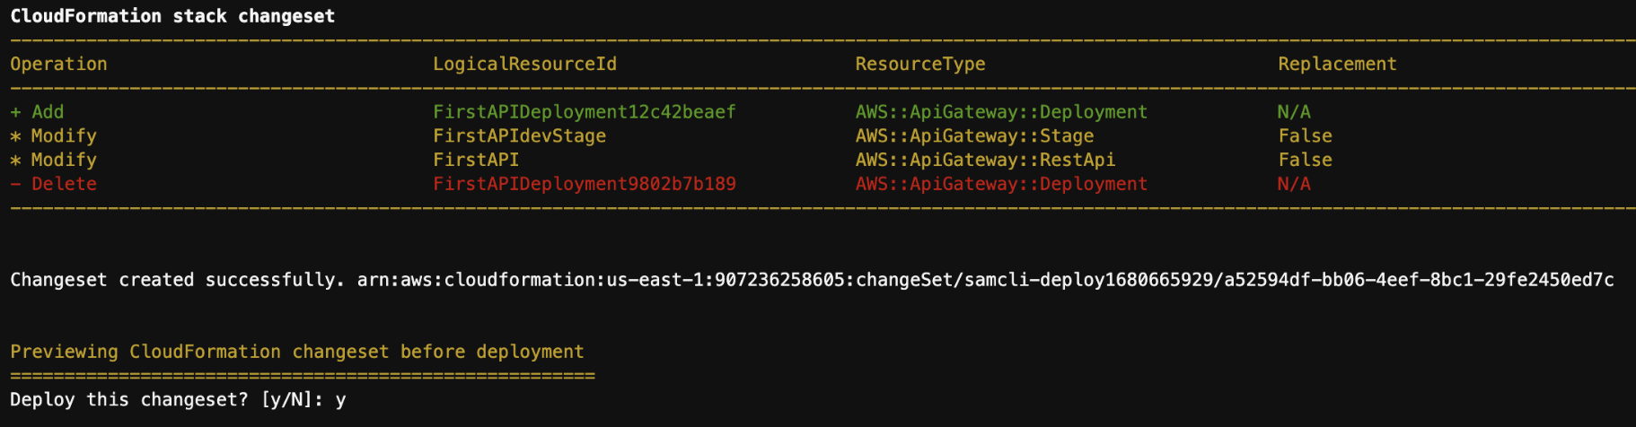
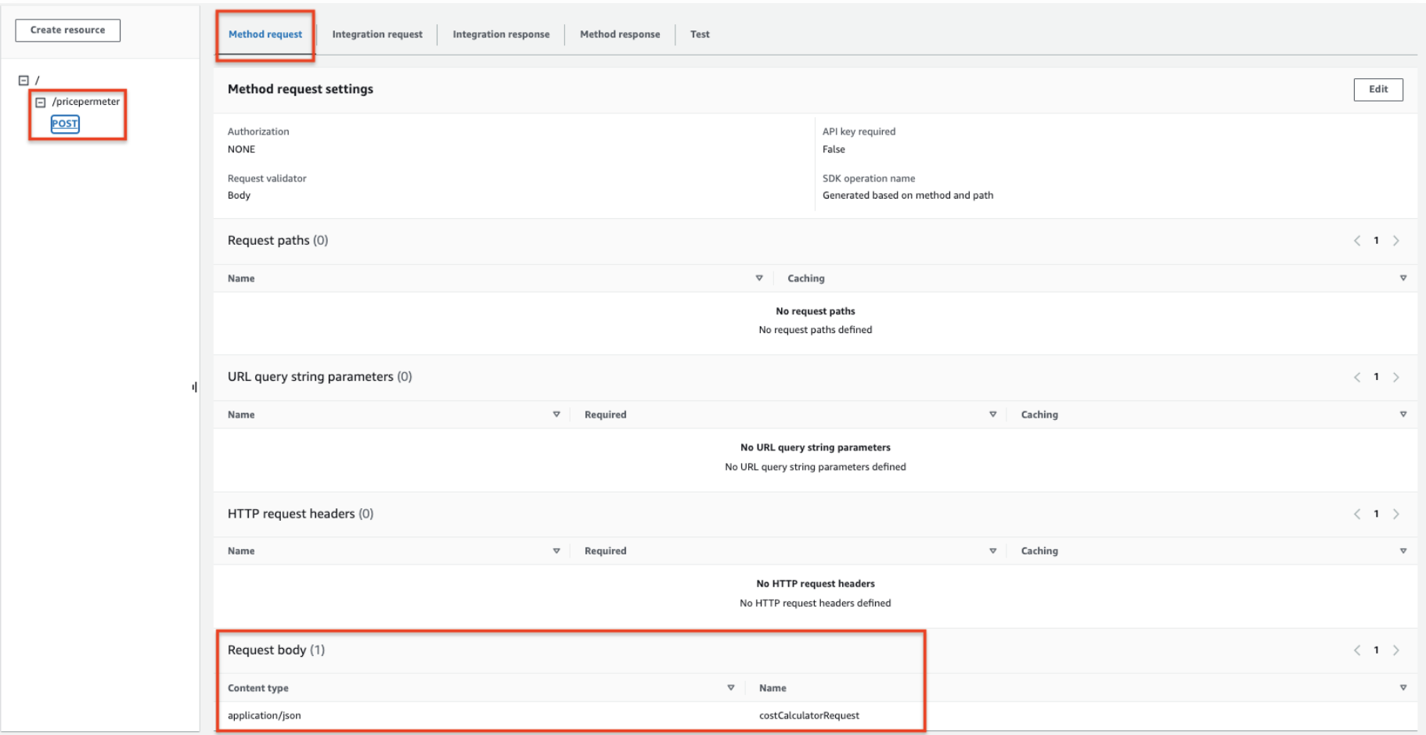
Data Transformation and Validation
Data Transformation is the process of cleaning, organizing and enriching raw data so it can be used for applications. We created a model for the data, validated and transformed incoming request messages to match the lambda specification
Request Validation is used to ensure that incoming request message is properly formatted and contains the proper attributes. Request Validators are set up in OPENAPI

Slide 12
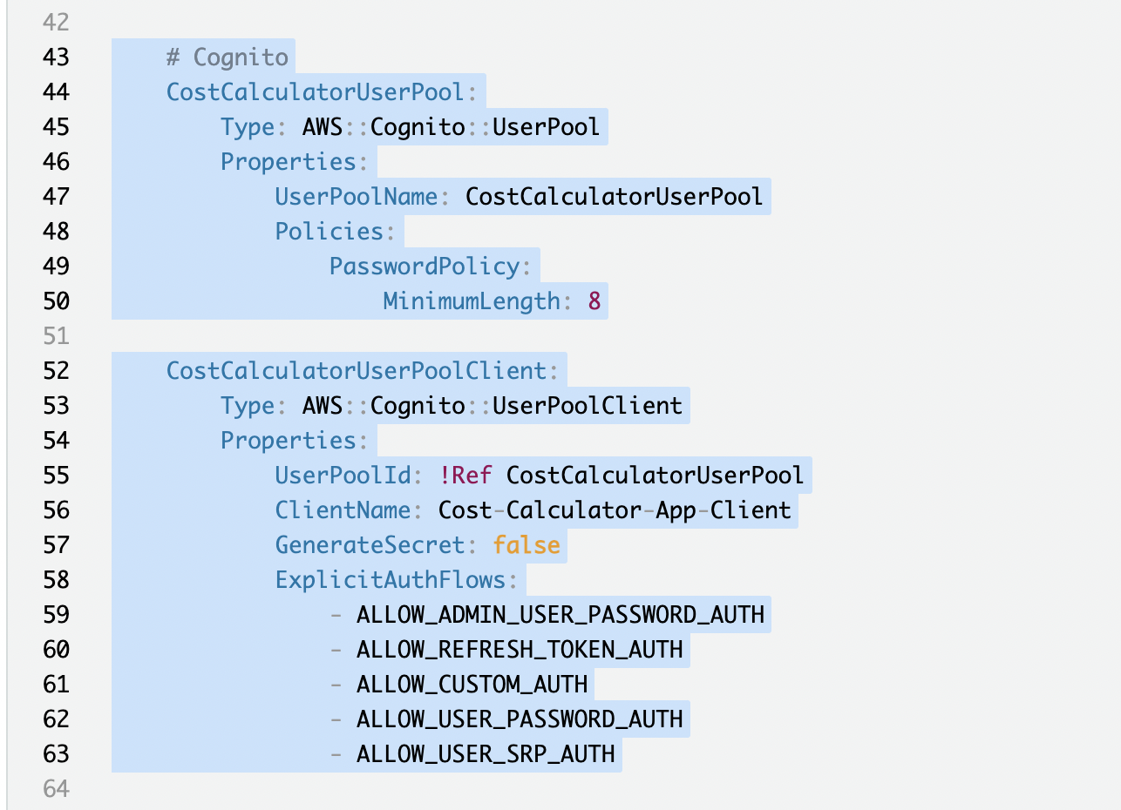
Authentication and Authorization
The first step is to create a Cognito User Pool which is a user directory for web and mobile app authentication
Then create a new user and finally test the API
Line 48-50 defines the policies
The User Pool name is CostCalculatorUserPool
User Pool policies include setting the minimum length, in this case 8 characters
Lines 52-63 define a User Pool Client
Line 56 defines the ClientName as Cost Calculator App Client
Line 57 is a Boolean to determine if there should be a secret
Lines 58-63 allows users to sign in with any combination or a custom process

Slide 13
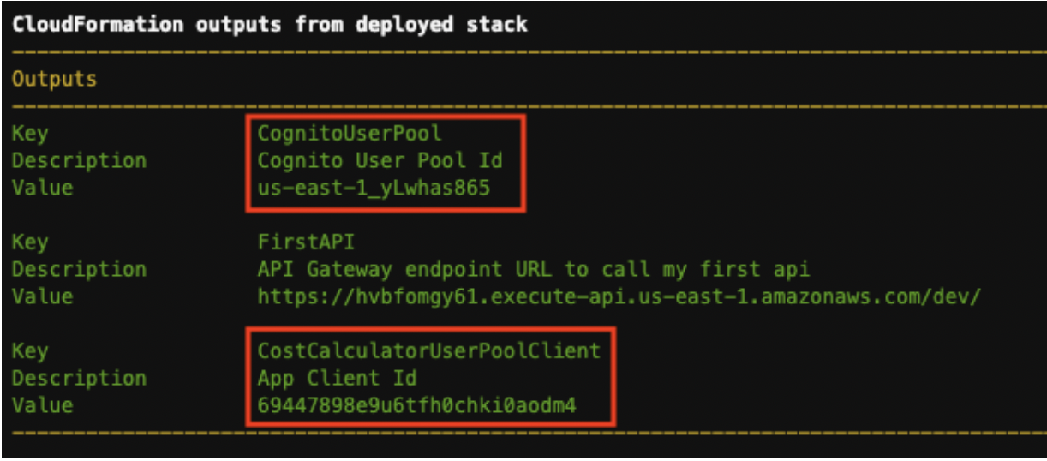
Authentication and Authorization
The stack was deployed using SAM
Cognito User Pool Id and the App Client Id created

Slide 14
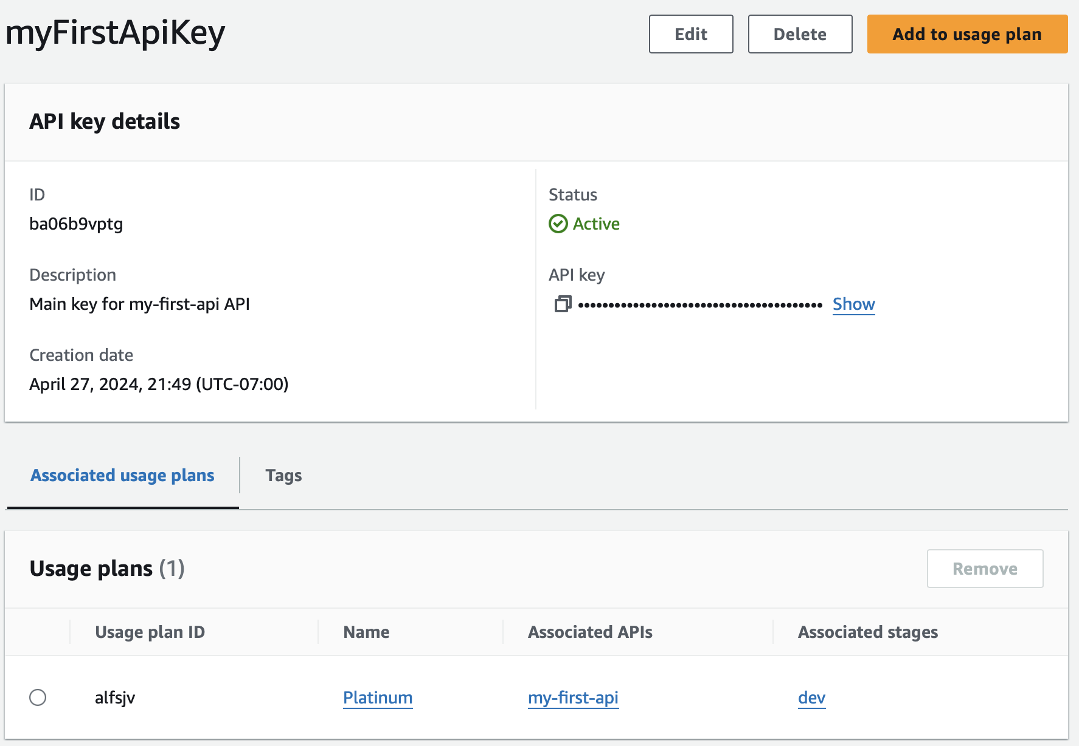
Usage and Message Throttling
Inserted new code for a new API Key to make request to the API
API Key will be linked to the Usage Plan that was previously created

Slide 15
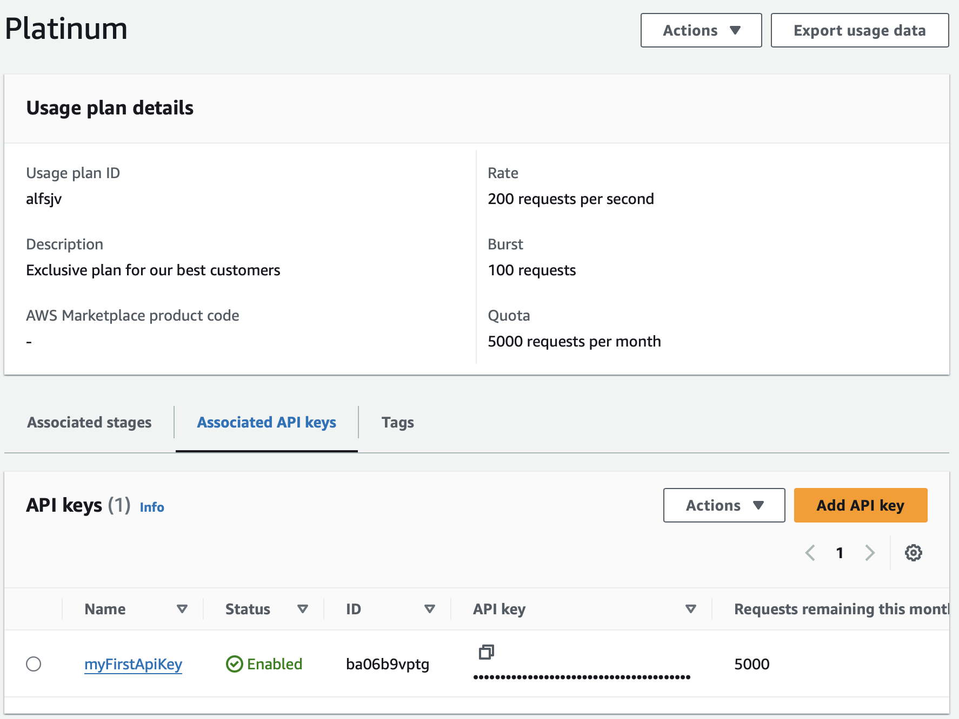
Usage and Message Throttling
Sets a target for the throttle and quota limits for APIs
This Usage Plan has a quota of 5,000 requests per month
Testing the Usage Plan, execute the command on the Cloud9 terminal, multiple times
This will simulate the usage and with an hour will update the number of requests

Slide 16
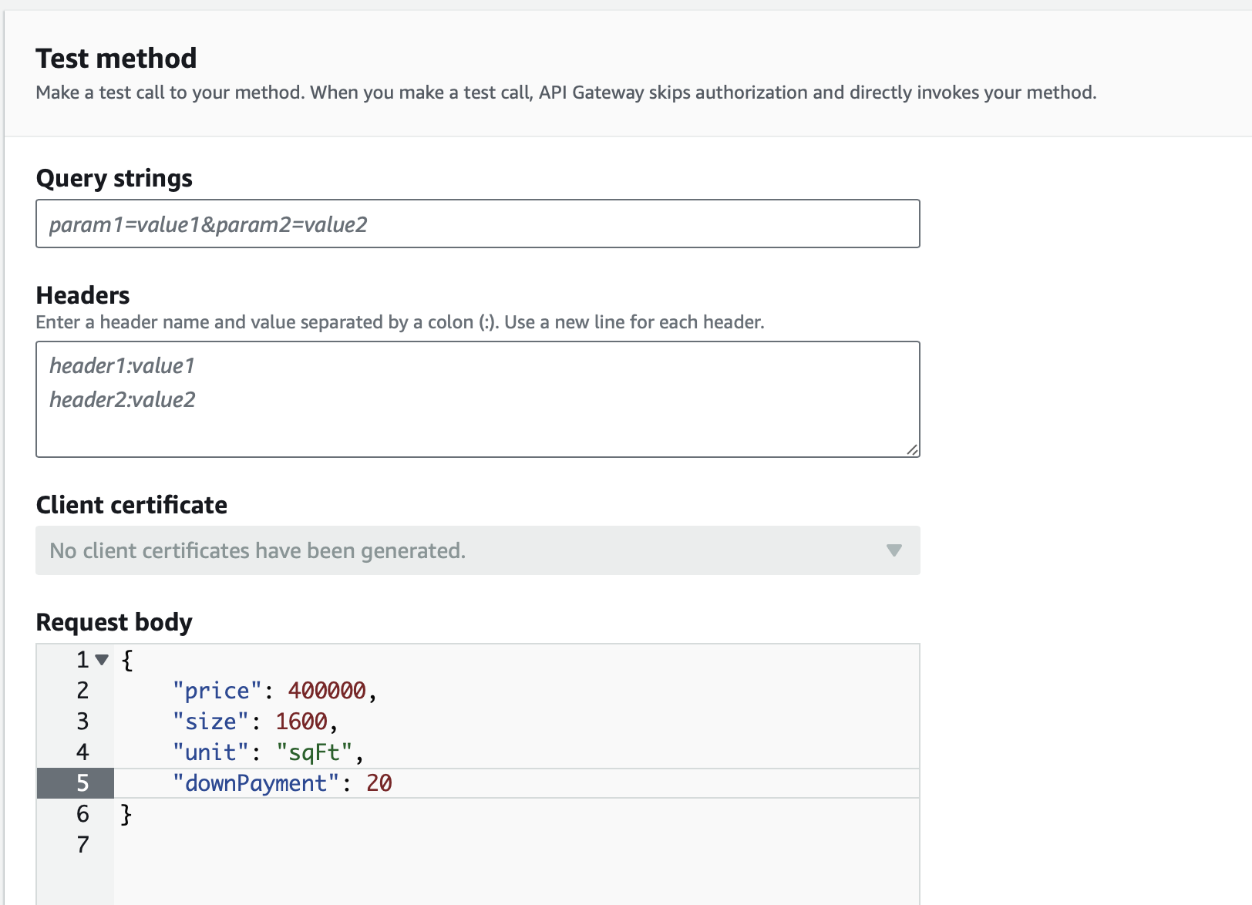
Test the API
Request Body
Provide the parameters we want the API to generate its response from
Goal
Generate the price per meter
Confirm there is an API ID and API Key

Slide 17
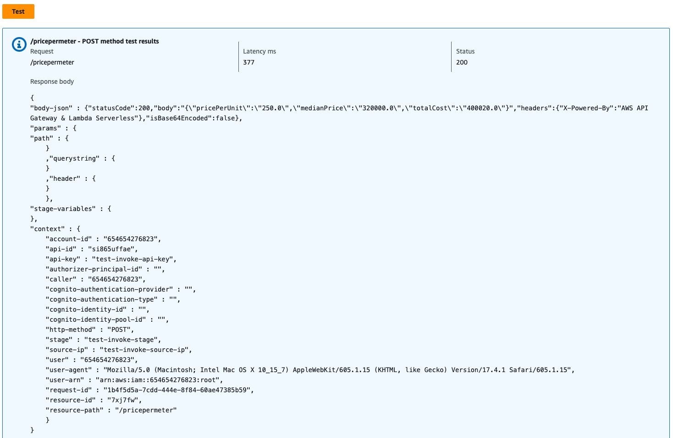
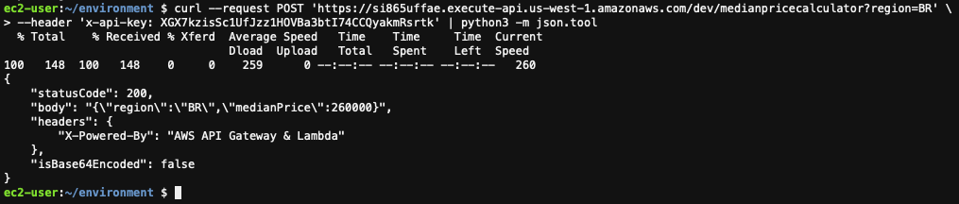
Test the API - Result

Slide 18

Business Case
Businesses want to utilize API calls to automate processes.
It reduces the need for manual intervention from the vendor
APIs minimize the risk of corrupted files when data is imported into the vendor's system
Ownership of maintaining the database is on the client and involves real-time data
Streamlines business processes and workflows via data exchange across various systems
Enhances business adaptability to new technologies, ensuring competitiveness and up-to-date operations

Slide 19
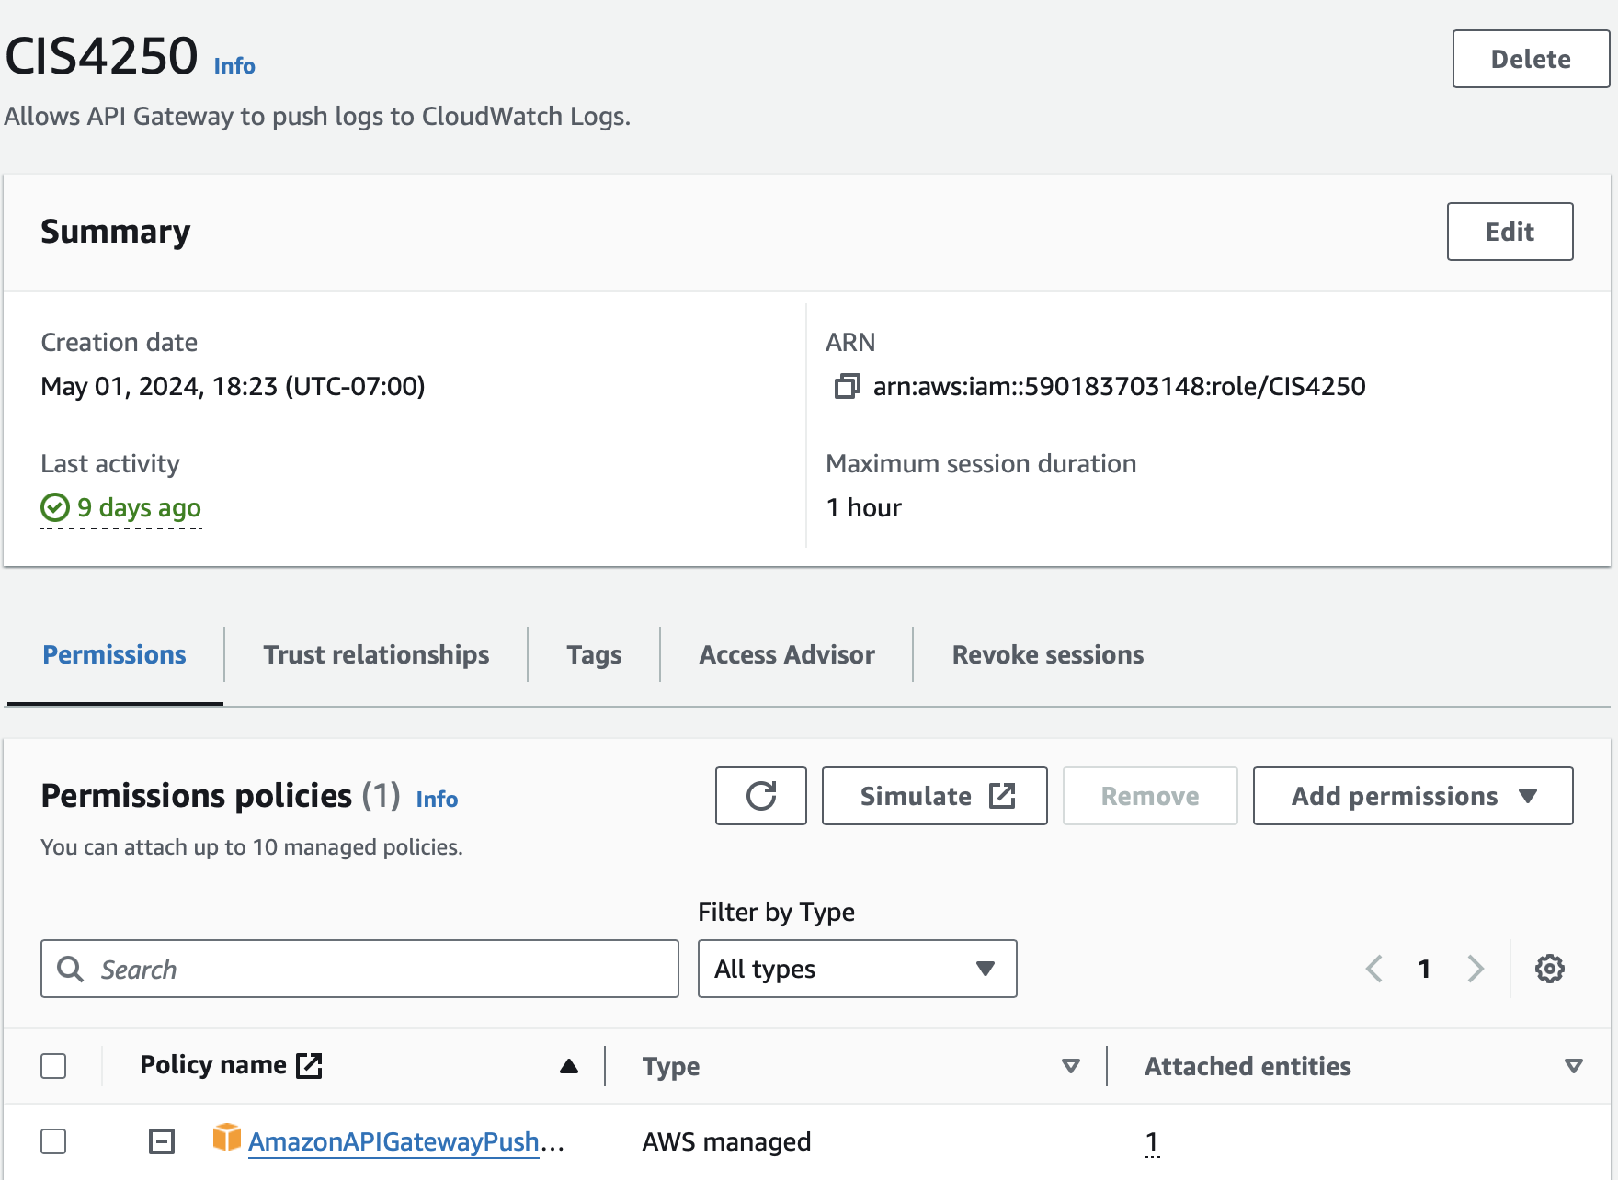
Project Roadblocks
Default AWS Permissions were not enough for us to initially start the project
We needed to create a new permission and role within IAM (Identify and Access Management) Service
The specific blocker we ran in to was that until we enabled "logging" of events from the API, we could not create the API
Part of the Usage Plans and Message Throttling included code to use Python, however, it should have been Python3
We needed to ensure that we are in the correct instance (i.e. us-west-2)

Slide 20
What we Learned
AWS can be very difficult to navigate as first-time users with no experience
Although creating the API was relatively easy, you need experience in computer science to build the API from scratch
We simply copied code of a function that was already pre-built
Building the function that is going to be used in the API itself can be daunting
Troubleshooting in AWS is difficult, but AWS provides a robust documentation library to support its users
Must have a can-do attitude

Slide 21
Project Summary
Built a serverless API using AWS SAM (Serverless Application Model) and OpenAPI
SAM streamlines application development with simple syntax for defining functions such as APIs, databases and sources
Code was written in YAML or JSON
Implemented features such as Request Validation, Authentication and, Authorization
Bonus features included Message Caching, Usage Plans and Message Throttling

Slide 22
References
https://youtu.be/_9xAOjjBRtU - Video Link
Workshop studio. (n.d.). https://catalog.us-east-1.prod.workshops.aws/workshops/4ff2d034-dee1-4570-93d9-11a54cc5d60c/en-US

